Slide 1

Adaptive Differential Privacy in Federated Learning: Real-Time Noise Scaling Based on Gradient Norm Sensitivity
Arnold Cobo
EE8227 - Secure Machine Learning
December 9, 2024

Slide 2
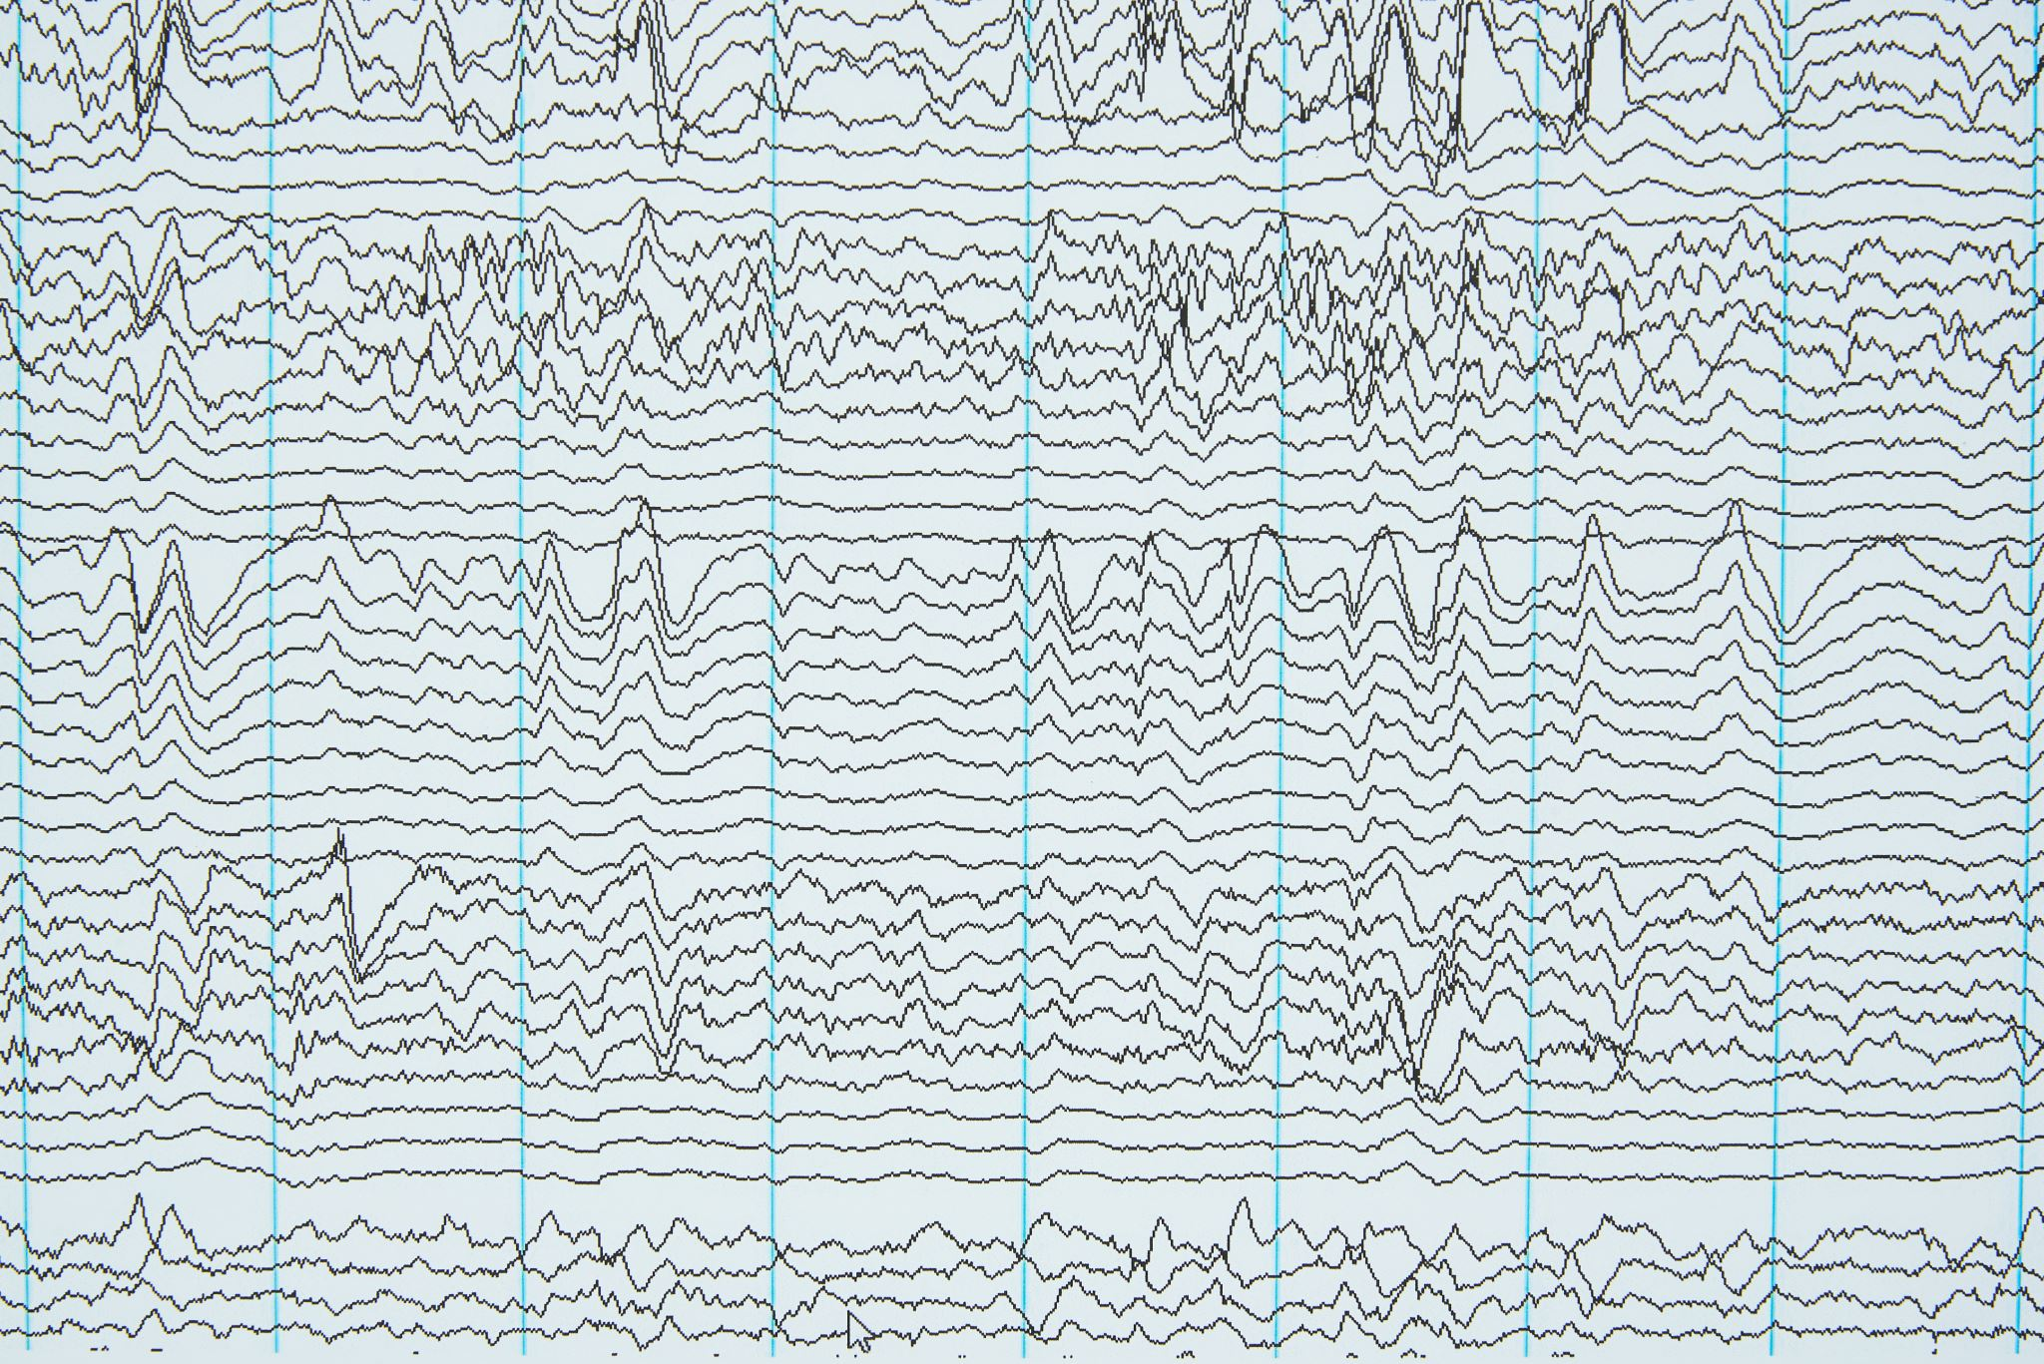
Motivation: Why is this Important?
In privacy-sensitive applications like healthcare, finance, and IoT, federated learning (FL) enables collaborative model training without sharing raw data. However, ensuring data privacy during training is challenging.
Differential Privacy (DP) is a key solution, but traditional DP uses static noise injection across all training rounds:
High noise ensures privacy but suppresses learning signals, degrading performance.
Low noise improves utility but risks compromising privacy guarantees.
Motivation & Problem Statement

Slide 3
Motivation & Problem Statement
Problem Statement: What’s the Challenge?
Static Noise Scaling: Existing methods apply the same noise multiplier to all batches and rounds, ignoring the sensitivity of individual gradients. This lack of flexibility results in:
Inefficient noise application.
Poor performance on heterogeneous (non-IID) data.
Non-IID Data Heterogeneity: When clients hold data with different class distributions, balancing privacy and model utility becomes even harder.
Static models struggle to adapt noise to the varying sensitivity of client updates.

Slide 4
Motivation & Problem Statement
Real-World Impact
In applications like healthcare and financial systems, models need to:
Deliver high accuracy while respecting strict privacy constraints.
Adapt to heterogeneous, non-IID datasets without compromising on learning quality.

Slide 5

Objectives & Goals
Adaptive Noise Scaling
Introduce real-time noise adjustment based on gradient sensitivity.
Noise levels adapt dynamically:
High gradients → More noise to protect sensitive updates.
Low gradients → Less noise to preserve learning signals.

Slide 6

Objectives & Goals
Dynamic Data Handling
Efficiently manage non-IID data (heterogeneous data distribution).
Reload dynamic subsets of client data across federated rounds to reflect realistic scenarios.
Incorporate 20% data overlap to simulate varying data availability.

Slide 7

Objectives & Goals
Evaluation Metrics
Model Utility:
Accuracy: Measure learning performance over rounds.
Loss: Track convergence and stability.
Privacy Guarantee:
Cumulative Privacy Budget (ε): Ensure strict differential privacy constraints are met.

Slide 8
Key Related Work
Differential Privacy in Federated Learning
Wang et al. (2020):
Proposed lightweight differential privacy (DP) for resource-constrained IoT devices.
Achieved privacy guarantees without compromising model accuracy [1].
Zhang et al. (2021):
Introduced hierarchical DP with dynamic privacy budget allocation.
Enabled fine-grained noise addition to sensitive model layers [2].
Liu et al. (2022):
Developed adaptive DP to dynamically scale noise based on client data sensitivity.
Demonstrated significant utility gains on non-IID data [3].

Slide 9
Key Related Work
Gradient Sensitivity and Dynamic Noise
Shen et al. (2022):
Integrated gradient sensitivity analysis to tailor noise levels before each training round.
Improved performance in non-IID federated settings [4].
Rao et al. (2022):
Combined sensitivity scaling with dynamic privacy budget scheduling.
Achieved 10% accuracy improvement over static models on non-IID data [5].
Zhang et al. (2023):
Proposed differentiated noise addition tailored to client-specific data heterogeneity [6].

Slide 10
Gaps and Contributions
Gaps in Existing Work
Static noise scaling fails to adapt to gradient variability in real time.
Limited focus on dynamic noise adjustments for non-IID federated data.
Incomplete exploration of noise sensitivity optimization during training rounds.
My Contributions
Enhanced Noise Personalization:
Real-time noise scaling based on gradient sensitivity thresholds.
Bridging the Non-IID Gap:
Dynamic data reloading combined with adaptive noise mechanisms.
Optimized Privacy-Utility Trade-off:
Achieved higher accuracy and faster convergence within static privacy constraints.

Slide 11
Methodology
Static Noise Model | Dynamic Noise Model
Configuration: Fixed Noise Multiplier: 0.8 Gradient Clipping: 1.0 Workflow: Federated Rounds: The model undergoes multiple training rounds across clients. Fixed Noise Injection: A constant noise level (0.8) is applied to gradients at each training step. Gradient Clipping: Gradients are clipped to a fixed norm (1.0) to limit sensitivity. FedAvg (Federated Averaging): Local model updates are aggregated on the server to produce the global model. | Two-Pass Training: Gradient Sensitivity Analysis: In the first pass, gradients are analyzed to calculate thresholds for low, medium, and high sensitivity batches. Noise Scaling: In the second pass, noise levels are dynamically scaled based on batch sensitivity. Configuration: Gradient Clipping: 10.0 Privacy Budget: The static model’s per-round privacy budget serves as a baseline to ensure fair comparison. Dynamic Data Reloading: 20% Overlap: A dynamic 20% overlap in client data subsets is introduced across rounds to handle non-IID data more effectively.

Slide 12
Experimental Setup
Dataset: MNIST (Non-IID)
Non-IID Data Distribution:
Client 0: Classes 0–4
Client 1: Classes 5–9
Federated Learning Setup
Rounds: 15 rounds of federated training
Batch Size: 16 samples per batch
Tools & Frameworks
Flower: Federated Learning (FL) framework for orchestration.
Opacus: Differential Privacy (DP) implementation for noise addition and privacy accounting.

Slide 13
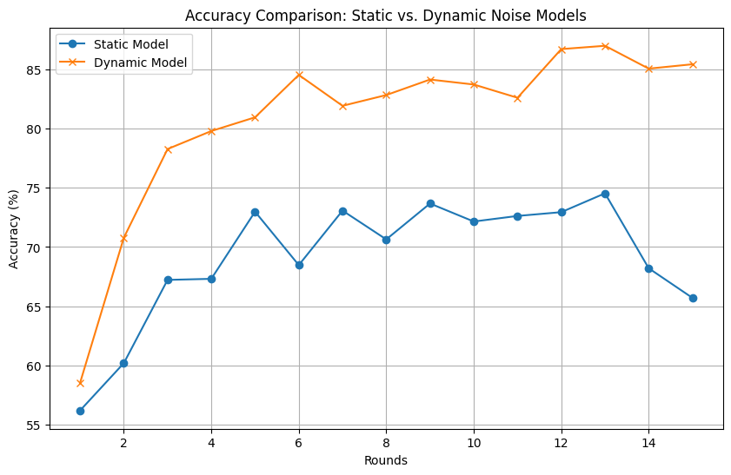
Results & Comparative Analysis
Accuracy Comparison

Slide 14
Results & Comparative Analysis
Accuracy Comparison
Insights:
Dynamic Model: Faster convergence and higher final accuracy.
Static Model: Final Accuracy = 65.70%
Dynamic Model: Final Accuracy = 85.43%
Key Takeaway: Dynamic noise scaling retains learning signals, enabling superior accuracy.

Slide 15
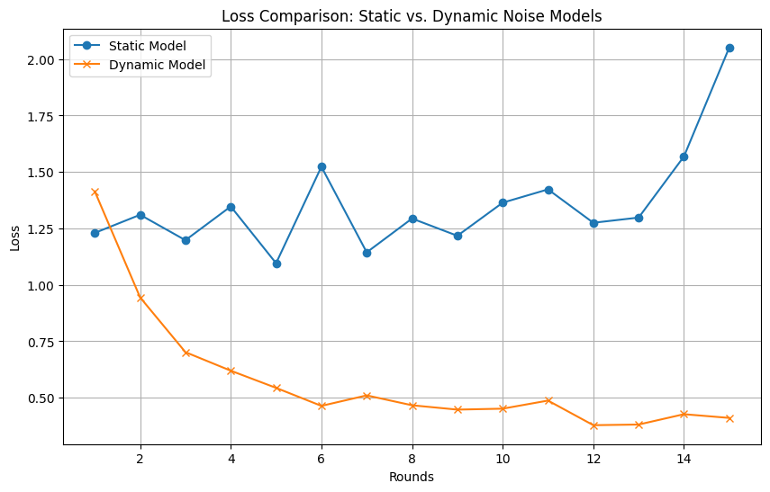
Results & Comparative Analysis
Loss Comparison

Slide 16
Results & Comparative Analysis
Loss Comparison
Insights:
Static Model:
Inconsistent loss reduction.
Overfitting after Round 10.
Final Loss = 2.0515
Dynamic Model:
Stable loss reduction throughout.
Final Loss = 0.4106
Key Takeaway: Dynamic model achieves smoother and more stable training.

Slide 17
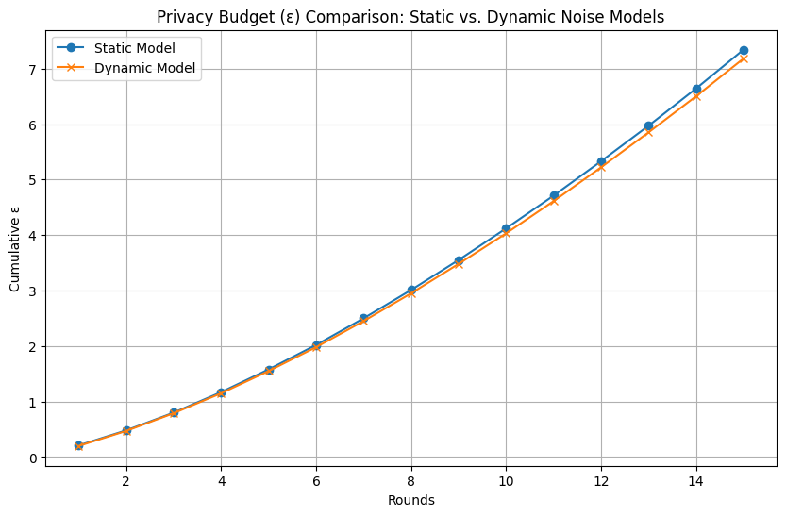
Results & Comparative Analysis
Privacy Budget (ε)

Slide 18
Results & Comparative Analysis
Privacy Budget (ε)
Insights:
Static Model: Final ε = 7.34
Dynamic Model: Final ε = 7.18
Key Takeaway: Dynamic model adheres to strict privacy constraints while delivering better performance.

Slide 19
Results & Comparative Analysis
Metric | Static Model | Dynamic Model
Accuracy (R15) | 65.70% | 85.43%
Loss (R15) | 2.0515 | 0.4106
Privacy Budget (ε) | 7.34 | 7.18
Convergence Rate | Slower | Faster
Key Takeaways:
Dynamic noise scaling consistently outperforms static noise in accuracy, loss, and convergence rate.
Maintains privacy (ε) while achieving superior model utility.

Slide 20
Conclusions & Future Directions
Key Conclusions
Dynamic Noise Adaptation:
Enhances model utility while maintaining strict privacy constraints.
Achieves:
Higher accuracy: Improved by nearly 20% compared to static noise.
Faster convergence: Stable learning on non-IID data.
Future Work
Scalability:
Extend experiments to larger datasets (e.g., CIFAR-10, real-world healthcare/finance data).
Evaluate in real-world federated systems with more clients and increased data heterogeneity.
Noise Optimization:
Further refine noise scaling parameters.
Minimize cumulative privacy budget (ε) while preserving model accuracy and utility.

Slide 21
References
Wang et al., "Lightweight Differential Privacy in Federated Learning," 2021.
Zhang et al., "Hierarchical Privacy Budget Allocation in FL," 2020.
Shen et al., "Gradient Sensitivity for Dynamic Noise Calibration," 2021.
Rao et al., "Dynamic Privacy Budget Schedulers for FL," 2022.
Zhang et al., "Differentiated Noise Addition for Non-IID Data in FL," 2020.
Liu et al., "Robust DP for Non-IID and Adversarial Settings," 2021.

